Slide 1
INSPIRE

Slide 2
Outline
Problem Statement
Proposed Approach and the Performance
Conclusion and On-going Work

Slide 3
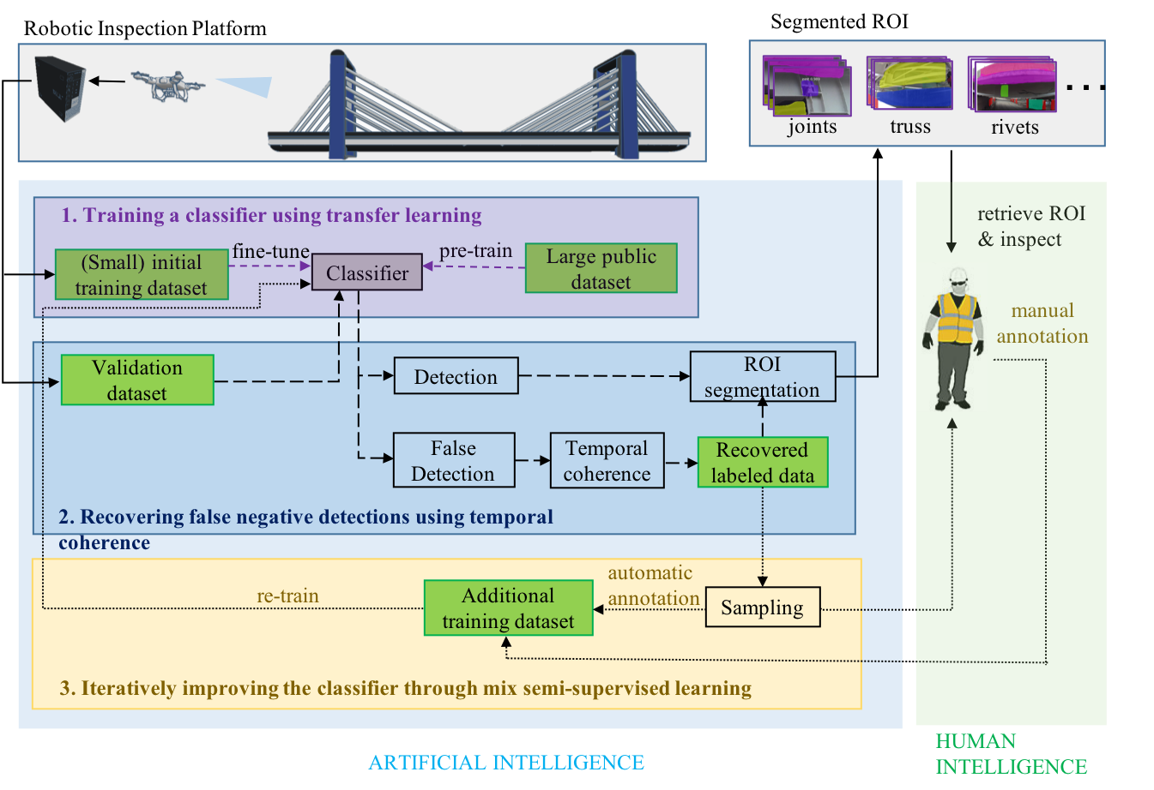
Assistive Intelligence for Bridge Inspection
Harmonious collaboration between human intelligence and artificial intelligence
Artificial intelligence for segmentation of ROI such as bridge elements for inspectors
Inspectors use human intelligence to retrieve and inspect ROI, and assist algorithm development

Slide 4
Research Tasks
Efficiently training a classifier using transfer learning
Recovering false negative detections using temporal coherence
Effectively improving the classifier using mix semi-supervised learning

Slide 5
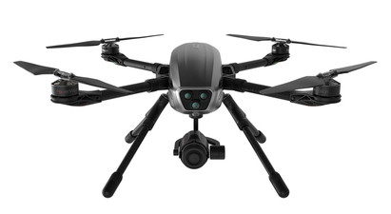
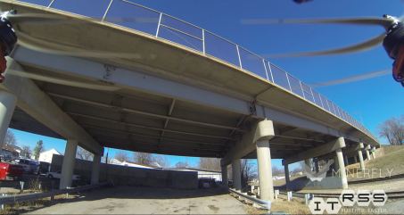
Segmentation Tool
Data acquisition
Segmentation tool: Mask RCNN
Long
video
…
Feature extraction
Classifier
Initial segmentation
…

Slide 6
The Mask RCNN Architecture for Bridge Element Segmentation
Notes:
A Mask Region-based CNN (Mask RCNN) performs detecting, localizing, region segmentation

Slide 7
The Mask RCNN – Feature Extraction
Initiation: Adopt the ResNet50 feature extractor pretrained on the Microsoft COCO dataset
Notes:
A Mask Region-based CNN (Mask RCNN) performs detecting, localizing, region segmentation

Slide 8
The Mask RCNN – Region Proposal Network
Region
Proposal Network (RPN):
creates region of interests (ROIs) and
extracts them from the feature map
Notes:
A Mask Region-based CNN (Mask RCNN) performs detecting, localizing, region segmentation

Slide 9
The Mask RCNN – Region of Interests (ROI) Align
Region of Interests(ROI) Align:
Aligns extracted feature maps with the original image and converts them into fixed size feature maps
Notes:
A Mask Region-based CNN (Mask RCNN) performs detecting, localizing, region segmentation

Slide 10
The Mask RCNN – The Network Head Branch
Network Head Branch:
Performs classification and bounding box generation
Notes:
A Mask Region-based CNN (Mask RCNN) performs detecting, localizing, region segmentation

Slide 11
The Mask RCNN – The Network Head Branch
Mask Branch:
Generates object instance masks
Notes:
A Mask Region-based CNN (Mask RCNN) performs detecting, localizing, region segmentation

Slide 12
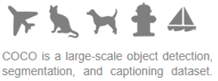
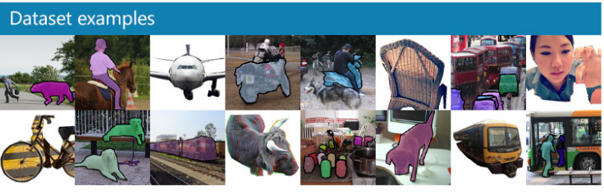
What is COCO?
COCO Dataset - Large Public Dataset
COCO dataset
120,000+ labeled images
1.5 millions of object instances
80 categories
Benefits
No need to train the entire network from scratch
Gain knowledge from large dataset, which is used as initial weights
Refine only a few layers

Slide 13
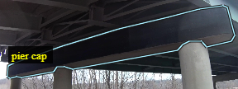
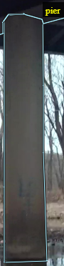
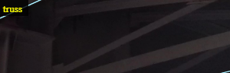
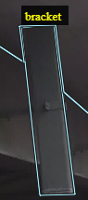
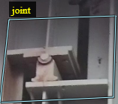
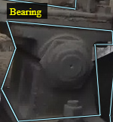
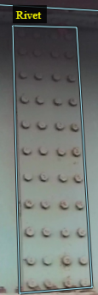
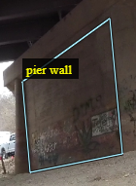
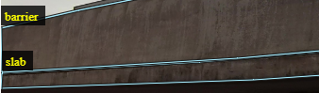
Small Initial Training Dataset
Training datasets: 40 images containing 482 labeled objects in 10 categories
10 classes of objects
1) Barrier
2) Slab
3) Bearing
4) Pier
5) Pier cap
6) Pier wall
7) Rivet
8) Truss
9) Bracket
10) Joint

Slide 14
Fine-tune the Mask CNN using Transfer Learning
Two-stage processes
Each epoch consists of 1000 iterations.
Stochastic gradient descent is used as the optimizer.
2.90 GHz Intel Xeon W-2102 CPU with 4 CPU cores, 16GB of RAM, and a NVIDIA Geforce GTX 1080 Ti GPU
Took about 13.5 hours to complete
 | Stage 1 | Stage 2
Layers for training | Network head branch Mask branch | Network head branch ResNet Backbone C5
# epochs* | 30 | 70
Learning rate | 0.001 | 0.0001

Slide 15
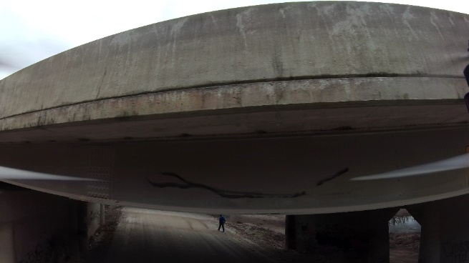
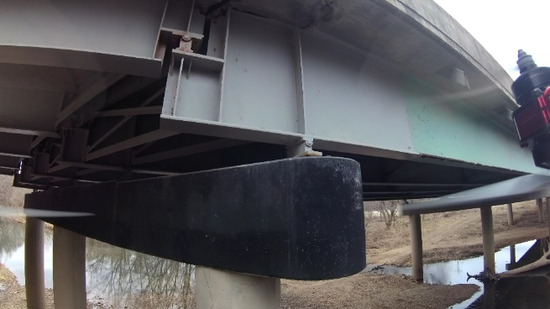
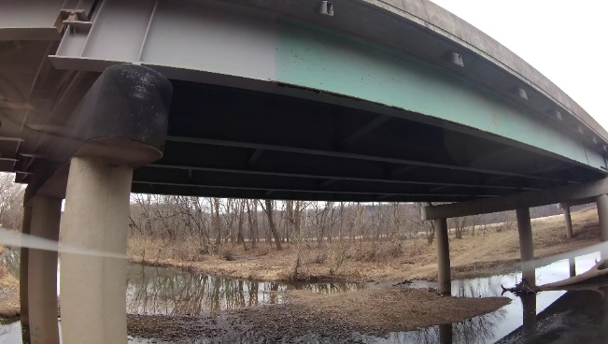
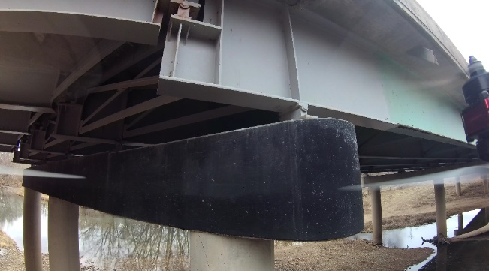
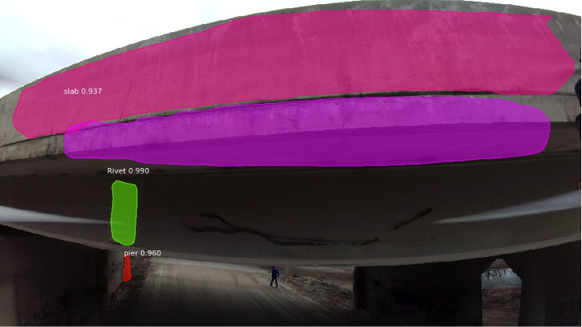
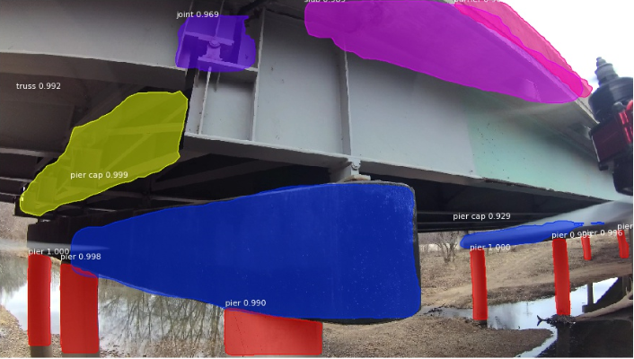
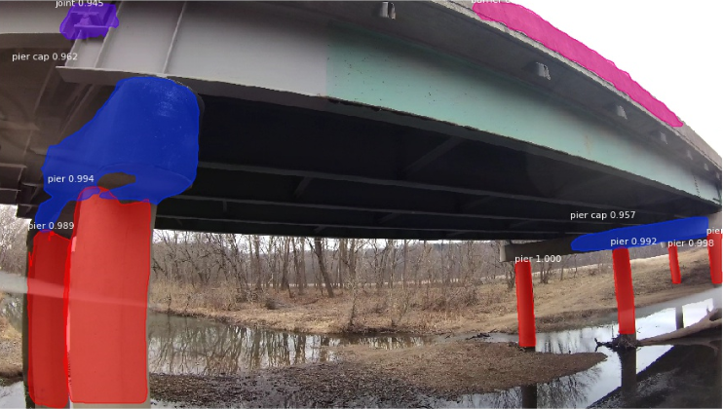
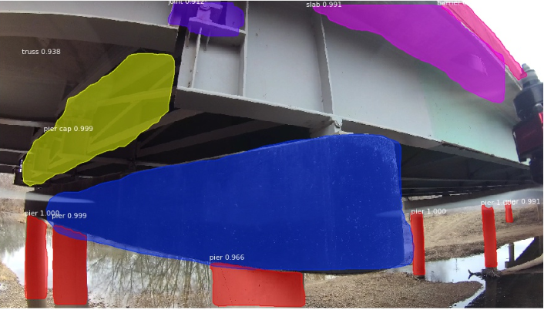
True Positive Detection – Correct Detection
Sample
Inspection data
with masks of ROI
Lack of illumination
Scale Variation
Viewpoint changes
Notes:
Lack of illumination: correctly segmented the Rivet(green) in low light
Scale Variation: segmented the joint in both large and small scale
Partial viewpoint: the partial joint is also segmented correctly

Slide 16
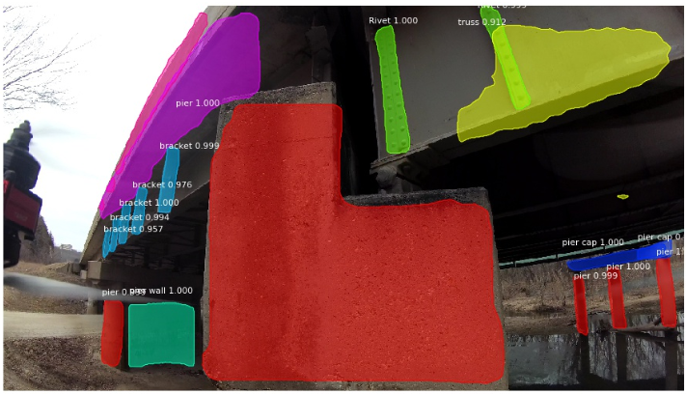
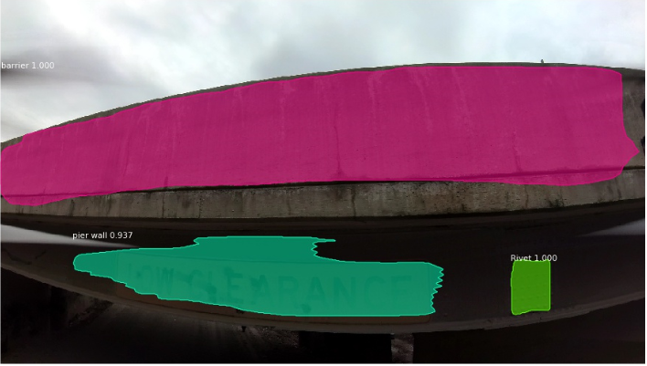
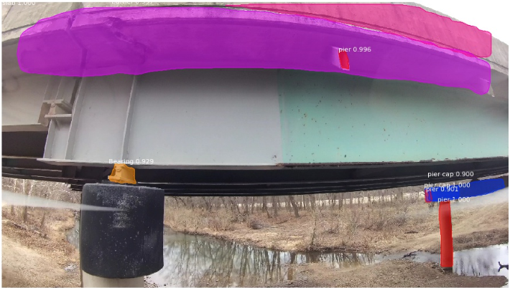





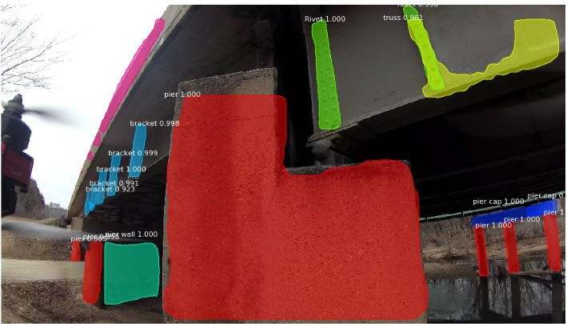
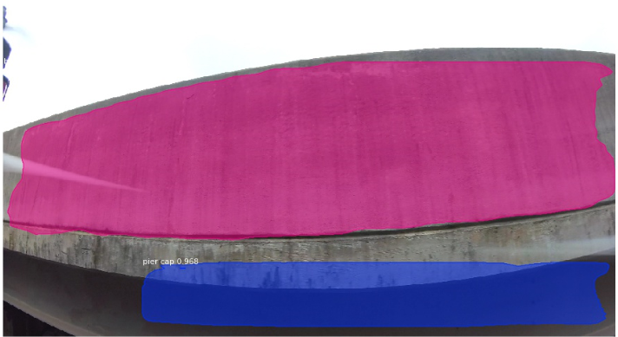
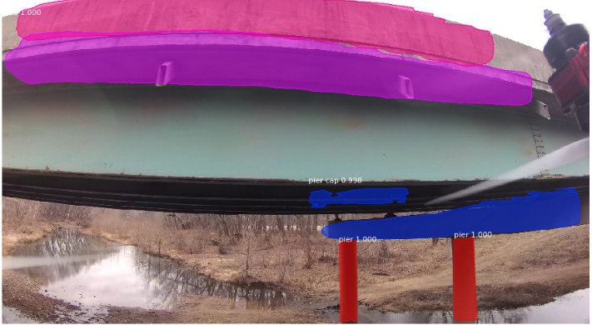





False Positive Detection – Incorrect Detection
 | Barrier
 | Slab
 | Bearing
 | Pier
 | Pier Cap
 | Pier wall
 | Rivet
 | Truss
 | Bracket
 | Joint
Legends
Notes:
The yellow circle indicates the false positive detection

Slide 17
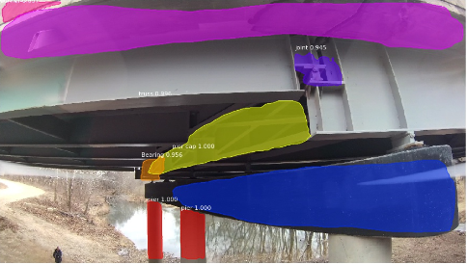
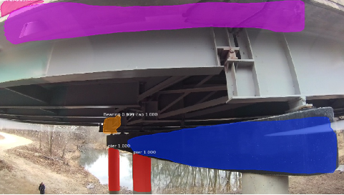
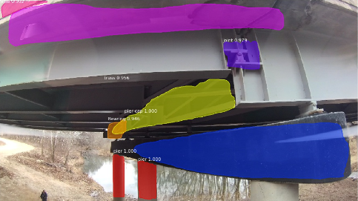
False Negative Detection – Failure in Detection
Frame 1
Frame 2
Frame 3
Joint and truss were not detected in frame 2

Slide 18
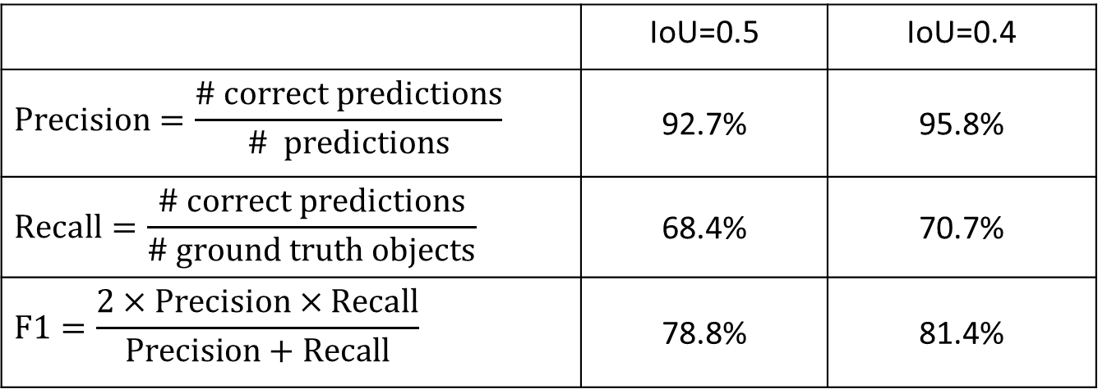
Test Results
Test dataset has 670 images of bridge A
5916 objects from 10 classes
Calculate precision, recall, and F1
 | IoU @ 0.5 | IoU @ 0.4
Total detections | 4367 | 4367
Correct detections | 4051 | 4184
 | IoU=0.5 | IoU=0.4
$$Precision=\frac{\# correct predictions}{\# predictions}$$ | 92.7% | 95.8%
$$Recall=\frac{\# correct predictions}{\# ground truth objects}$$ | 68.4% | 70.7%
$$F1=\frac{2×Precision×Recall}{Precision+Recall}$$ | 78.8% | 81.4%
# false negative detection is not small
Notes:
Monjurul, let’s be consistent by keeping one digit after the decimal.
Please also add the missing numbers in this slide

Slide 19
Mask RCNN is a Static Image Detector
Inconsistent detection along successive frames of image in videos
Frame 1
Frame 2
Frame 3
Joint and Truss is not detected in frame 2, but are detected in frames 1 and 3

Slide 20
Research Tasks
Efficiently training a classifier using transfer learning
Recovering false negative detections using temporal coherence
Effectively improving the classifier using mix semi-supervised learning

Slide 21
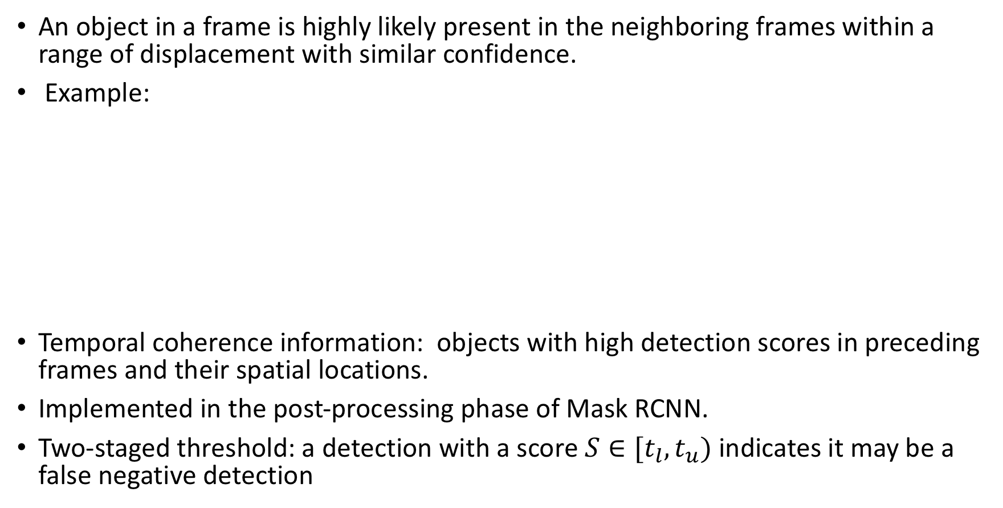
Temporal Coherence
An object in a frame is highly likely present in the neighboring frames within a range of displacement with similar confidence.
Example:
Temporal coherence information: objects with high detection scores in preceding frames and their spatial locations.
Implemented in the post-processing phase of Mask RCNN.
Two-staged threshold: a detection with a score $S∈[t_{l},t_{u})$ indicates it may be a false negative detection
Notes:
a joint of the bridge in frame $i−4$ was also shown in the succeeding four frames but with displacements.

Slide 22
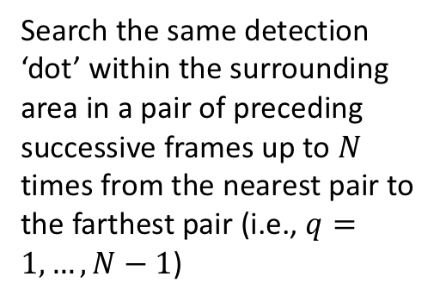
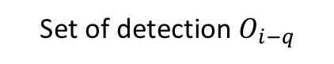
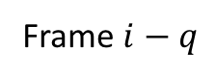
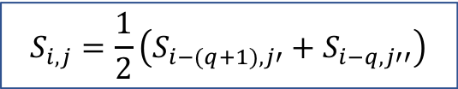

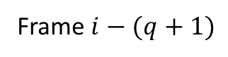
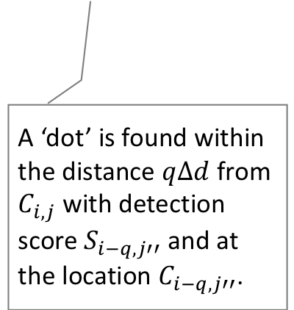
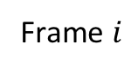
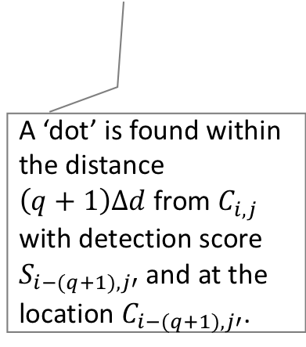
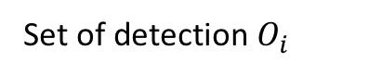
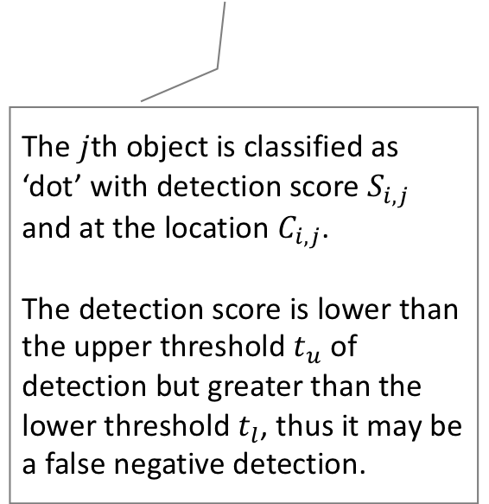
Recover False Negative Detection
Frame $i−(q+1)$
Frame $i−q$
…
Frame $i$
Set of detection $O_{i−(q+1)}$
Set of detection $O_{i−q}$
Set of detection $O_{i}$
Search the same detection ‘dot’ within the surrounding area in a pair of preceding successive frames up to $N$ times from the nearest pair to the farthest pair (i.e., $q=1,…,N−1$)
The $j$th object is classified as ‘dot’ with detection score $S_{i,j}$ and at the location $C_{i,j}$.
The detection score is lower than the upper threshold $t_{u}$ of detection but greater than the lower threshold $t_{l}$, thus it may be a false negative detection.
A ‘dot’ is found within the distance $\left(q+1\right)∆d$ from $C_{i,j}$ with detection score $S_{i−(q+1),j′}$ and at the location $C_{i−(q+1),j′}$.
A ‘dot’ is found within the distance $q∆d$ from $C_{i,j}$ with detection score $S_{i−q,j′′}$ and at the location $C_{i−q,j′′}$.
Recover this “false negative” detection by updating the detection score
$$S_{i,j}=\frac{1}{2}\left(S_{i−(q+1),j′}+S_{i−q,j′′}\right)$$

Slide 23
An Example
The model failed to detect a truss
Before:
After:
The truss was detected using the temporal coherence information

Slide 24
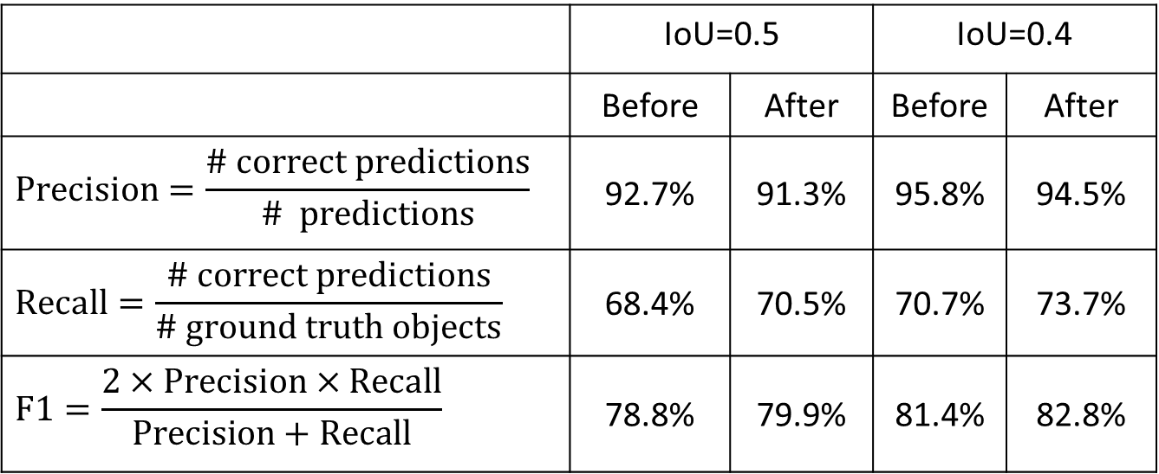
Test Results
Test dataset has 670 images of bridge A
5916 objects from 10 classes
Calculate precision, recall, and F1
IoU @ 0.5 | Before | After
Total detections | 4367 | 4569
Correct detections | 4051 | 4174
IoU @ 0.4 | Before | After
Total detections | 4367 | 4569
Correct detections | 4184 | 4342
 | IoU=0.5 |  | IoU=0.4
 | Before | After | Before | After
$$Precision=\frac{\# correct predictions}{\# predictions}$$ | 92.7% | 91.3% | 95.8% | 94.5%
$$Recall=\frac{\# correct predictions}{\# ground truth objects}$$ | 68.4% | 70.5% | 70.7% | 73.7%
$$F1=\frac{2×Precision×Recall}{Precision+Recall}$$ | 78.8% | 79.9% | 81.4% | 82.8%
# false negative detections is reduced by 3% approximately

Slide 25
Limited Capability of Time Coherence
Time coherence information can help recover some false negative detections, but not all of them.
Improvement the Mask RCNN model is required!
Let human experts help the model learn to recognize objects that are hard to be detected.

Slide 26
Research Tasks
Efficiently training a classifier using transfer learning
Recovering false negative detections using temporal coherence
Effectively improving the classifier using mix semi-supervised learning

Slide 27
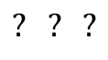
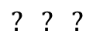
Semi-Supervised Learning (SSL)
Manually labeled data
Use manually labeled data to train the model
Save labor time for data labeling
Quality of automatically labeled data is determined by the model performance, which is affected by the quality of training dataset
Domain experts can provide high quality human-labeled data
How much data should be labeled by experts?
labor time increases linearly
Marginal improvement is diminishing
It is difficult to determine the optimal amount of data to be labeled by experts.
model
Use the trained model to automatically predict labels of unlabeled data
Unlabeled data
Re-train the model using manually labeled and automatically labeled dataset
$$? ? ?$$
$$? ? ?$$
$$? ? ?$$
Automatically labeled data

Slide 28
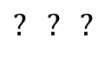
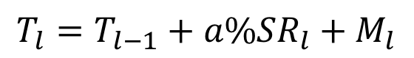
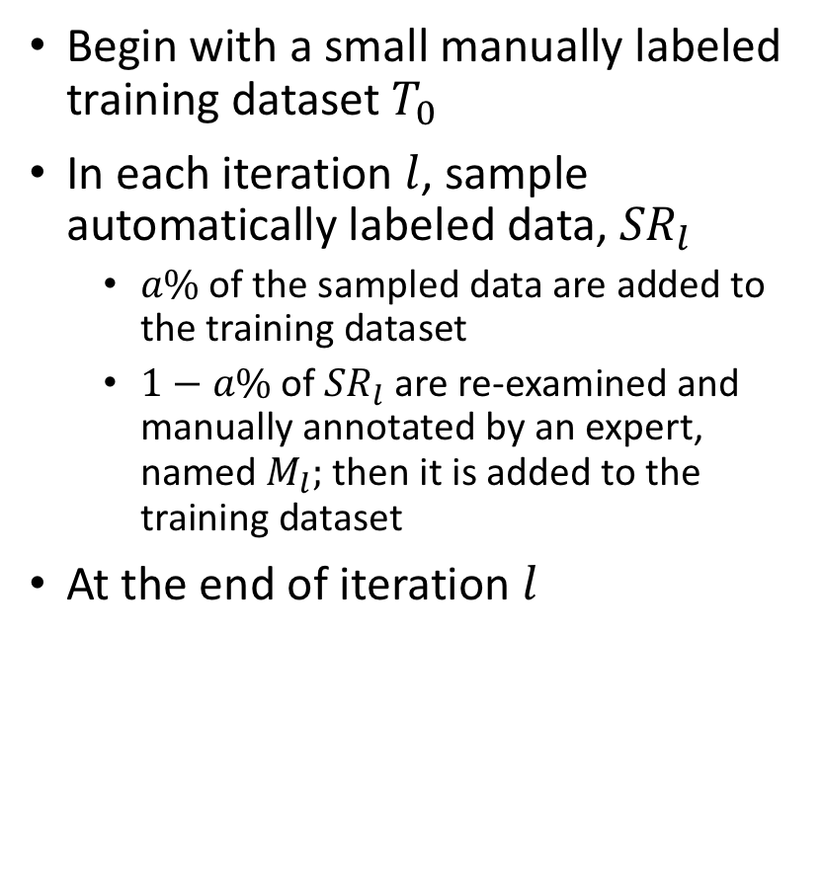
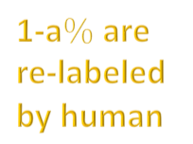


Iterative SSL - Search an Optimal Model Iteratively
Manually labeled data
Use manually labeled data to train the model
Begin with a small manually labeled training dataset $T_{0}$
In each iteration $l$, sample automatically labeled data, ${SR}_{l}$
$a\% \text{of} \text{the} \text{sampled} \text{data} \text{are} \text{added} \text{to} \text{the} \text{training} \text{dataset}$
$1−a\%$ of ${SR}_{l}$are re-examined and manually annotated by an expert, named $M_{l};$ then it is added to the training dataset
At the end of iteration $l$
model
Use the trained model to automatically predict labels of unlabeled data
Re-train the model using manually labeled and automatically labeled dataset
Unlabeled data
$$? ? ?$$
$$? ? ?$$
$$? ? ?$$
Automatically labeled data
1-a$\%$ are re-labeled by human
$$T_{l}=T_{l−1}+a\%{SR}_{l}+M_{l}$$

Slide 29

Iterative Mix Semi-Supervised Learning

Slide 30


Mix Iterative Semi-Supervised Learning
Initialization through supervised learning
Initial training dataset $T_{0}$
Sample 1% of tested data, which are false detections, to manually annotate, obtaining $M_{0}$
Add $M_{0}$ to $T_{0}$ to form the training dataset for the 1st iteration, $T_{1}$
$$T_{1}=T_{0}+M_{l}$$

Slide 31


Mix Iterative Semi-Supervised Learning
Iteratively search the desired model through SSL
Retrain the model using training dataset $T_{l}$
Sample representative hard recovered data, ${SR}_{l}$
Manually annotate (1-$a$%) ${SR}_{l}$ to obtain dataset $M_{l}$
Update the training dataset for the next iteration
$$T_{l+1}=T_{l}+M_{l}+(1−a\%){SR}_{l}$$

Slide 32

Sampling Data to Be Added to the Training Dataset
Sample hard recovered data that the current model has difficulty in detection
Use skip sampling to select representative data because recovered consecutive frames are similar
a% decreases over iterations. The effort of human intelligence can be gradually reduced as the performance of artificial intelligence algorithm is increasing
$$Equaiton 1$$
I explained equation 1 in next slide
Notes:
Check Equation 1. It seems not correct to me.
Iteration 0 (initialization), Iteration 1 (a%=30%), Iteration 2 (a%=20%), Iteration 3 (10%) please update the figure. We are suppose to have four subplots

Slide 33





This slide is the clarification of equation 1.
In the figure, blue frames indicate that, temporal coherence recovered that frame.
If this difference between two consecutive recovered frame is more than d, then $R_{(k+1,l)}$ will get selected. For this study we assumed that 3 consecutive frames will be identical (d=3). So, if one frame gets selected from the recovered image, next three frames will not be selected.
$$R_{(k,l)}=53$$
$$R_{(k+1,l)}=80$$
Here, $R_{(k+1,l)}−R_{\left(k,l\right)}=80−53=27>3.$ Therefore, 80th frame will be selected. For next recovered pair, $R_{(k+1,l)}−R_{\left(k,l\right)}=81−80=1<3.$ Therefore, frame 81 will not be selected.

Slide 34
Examples of Successful Detection
All 10 classes of bridge elements in three bridges can be detected
The developed approach accurately segmented objects in the presence of lots of viewpoint changes, scale variations, and lack of illumination.
An accurate instance level segmentation is also observed when multiple objects occlude each other.
Notes:
Monjurul: Can you please a little more detailed discussion of these examples?

Slide 35


Two Iterative Scheme
C1: a% takes 30%, 20%, and 10% in a decreasing order
C2: a% takes 40% and 30% in a decreasing order
Notes:
Does the human hours include annotating the training dataset?
Yes

Slide 36

Lower the Threshold of Detection
reduce false negative detections but may increase false positive detections
IoU is reduced from 0.5 to 0.4
Better performance is achieved at IoU=0.4

Slide 37

Mean Average Precision
IoU = 0.4, 0.5, 0.6, and 0.75
At IoU = 40% and 50%, mAP gradually increases over iterations
At IoU =60% and 75%, mAP demonstrates a humped curve over iterations
The mAP curve decreases rapidly along with the increasing IoU

Slide 38

Recall vs IoU
$$recall=\frac{\# correct detections}{\# ground truth}$$
# correct detections = (recall) (#ground truth)
IoU increases → # detections decreases
IoU increases → recall decreases
IoU increases → # correct detections decreases
Notes:
Monjurul: Please explain these two figures in detail
# ground truth = #correct detection + #false negative detection
-------------------------------------------------------------------------
Eliminating false negative detection is the most important task in assistive intelligent model. Because, if an important region is ignored by the detector, it may not be considered for inspection by the human inspector, which can lead to a catastrophe.
Higher value of recall indicates the lower number of false negative detection. Therefore, we compute the recall of the proposed model at different IoU ratios with ground truth boxes.
In both the figures (C-1 & C-2), Recall values remain consistent within the range of 5%, if we increase the IoU value from 0 to 0.5. For instance in the left hand side figure (C-1), after iteration 1, recall value is 0.74 when iou is 0.1. This value decreases to 0.71 when iou is increased to 0.5.
In the following 4 iterations, the recall value increases by around 12%, 6%, 2% and 1%, respectively from their previous iteration, throughout the IoU value 0.1 to 0.6. After each iteration, the detector learns new features and moves toward the saturation level of it’s learning limit. Therefore, the improvement rate gradually decreases after each iteration.
For IoU value 0.7 and 0.8, recall remains within the range of 0.42 to 0.75 in all iterations. And for more than 0.8 IoU, recall value falls under 10% for every iteration. The reason for this sharp decrease of recall value with the increase of IoU value is that, if we increase the iou value the detector concentrate more on pixel level accuracy. To be considered as a true positive detection the detection mask has to be very accurate in pixel level with the ground truth when the IoU value is high. Therefore, to minimize the false negative detection, we can reduce this threshold when pixel level accuracy is not first priority.
Same pattern is also observed with training scheme C-2.

Slide 39
Conclusions

Slide 40
Future Work

Slide 41
Examples of Failure Detection
The red bounding boxes in the figure represents the
Failed to detect the truss correctly due to the angle of view
Monjurul: it shows pier cap 0.999. Is this a false positive detection?
- No, it is the label for correctly detected pier cap (blue)
Failed to detect the pier cap correctly due to the angle of view
Monjurul: it shows pier 0.999. Is this a false positive detection?
- No, it is the label for correctly detected pier (red)
Failed to detect the barrier due to high exposure and failed to detect the rivet because of the similar appearance with the background.
Notes:
This slide goes to conclusion

Slide 42
Acknowledgement
Funding provided by US-DOT INSPIRE UTC
CS and EMSE Departments of Missouri S&T

